Slide 1

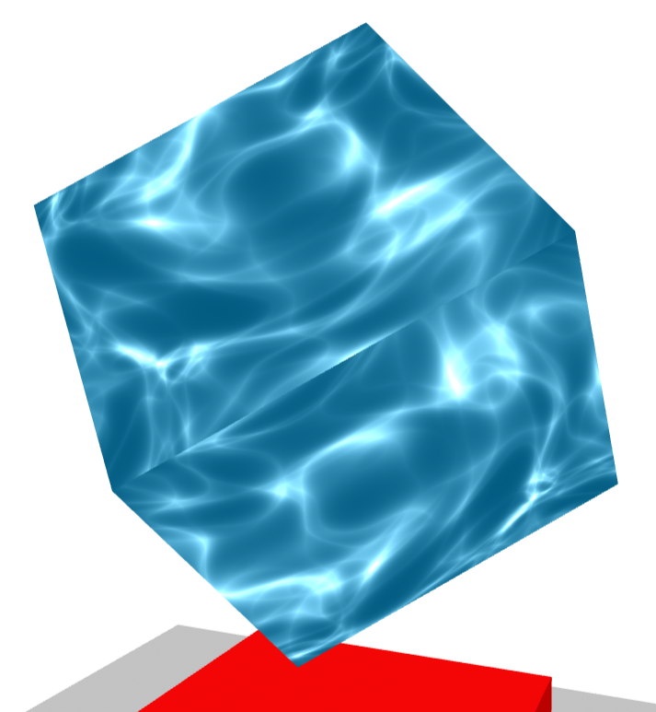
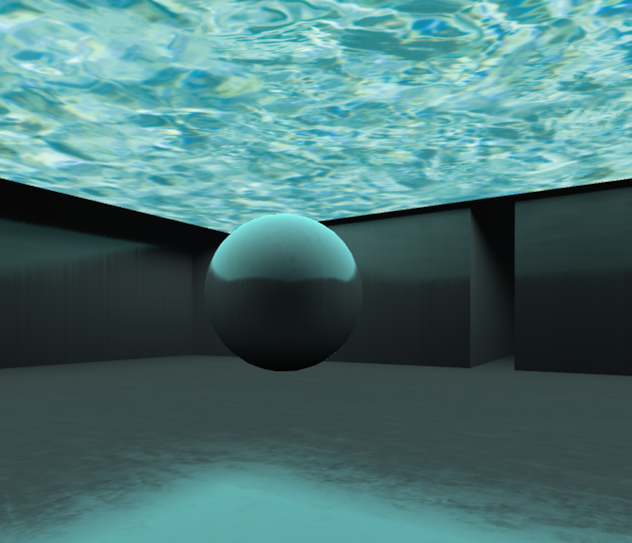

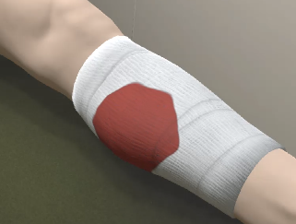
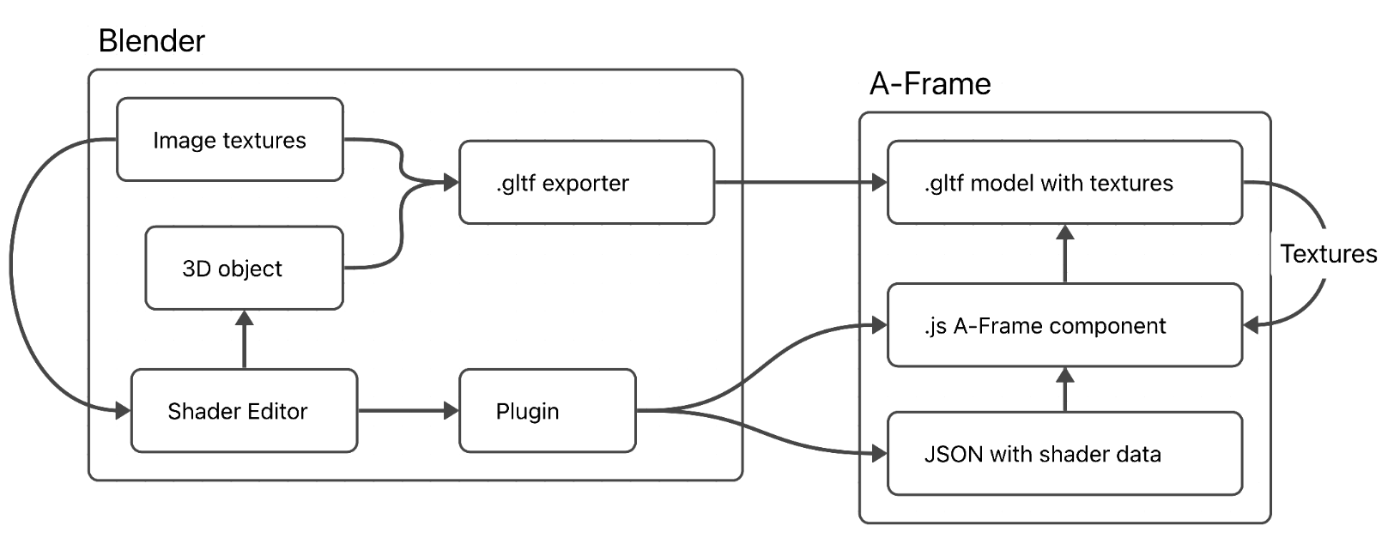

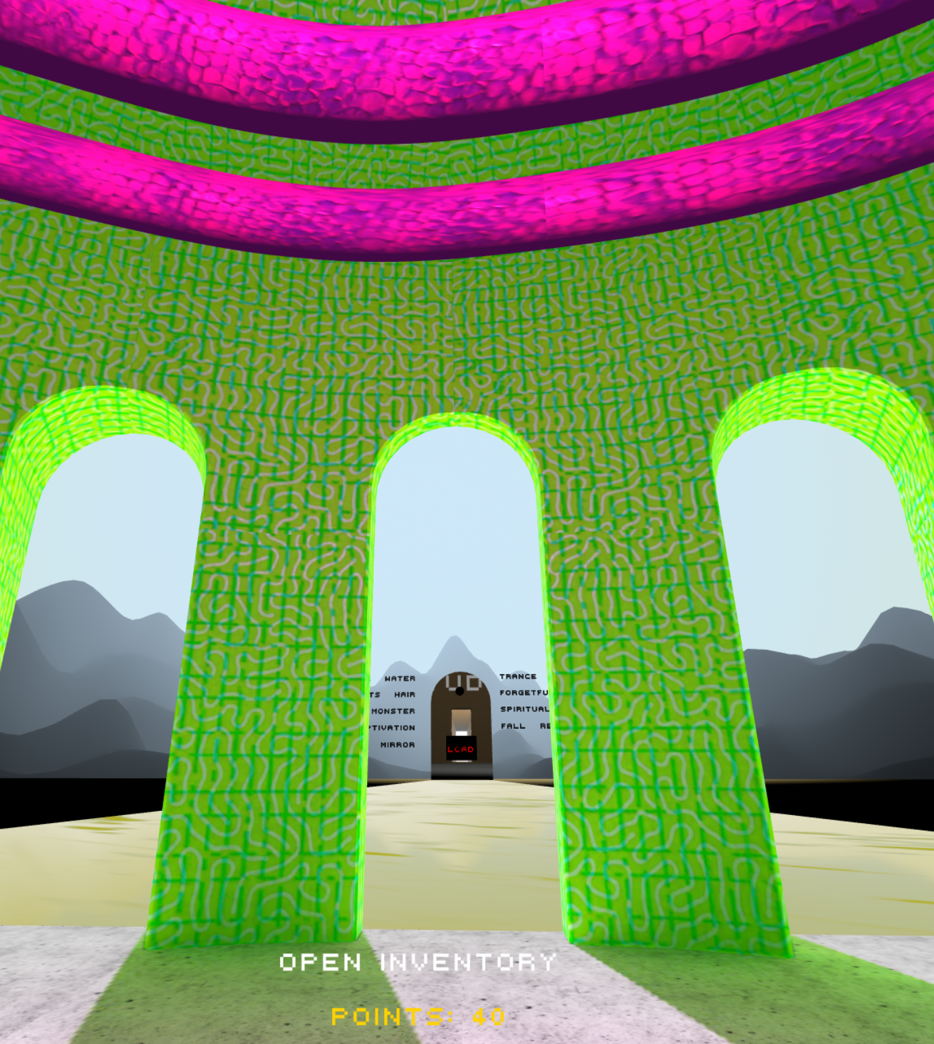


Creation of virtual reality experiences for the web: shader programming for artists
Alvis Misjuns, Arnis Cīrulis
Vidzeme University of Applied Sciences
ImGame – An Innovative Digital Environment Based on Research with Elements of Immersive Aesthetics and Serious Gaming
No. 101054570 (2022-2025)
Introduction
1) A custom version of ChatGPT with predefined parameters, that creates or converts existing GLSL shaders to a A-Frame shader component.
Example on the right –
prompt: water ripples
Link to the configured ChatGPT:
Extensive polishing of the parameters are still required and the results are not always guaranteed as intended.
Virtual Reality (VR) has established itself as a reliable and efficient tool for education and training, simulating environments that otherwise would be impossible or difficult to organise in a physical environment. In these fields, it is important to create convincing and accurate 3D visualisations, e.g. traumas, lighting, interaction effects and other processes that enhance immersiveness. Creating visualisations requires skills in 3D modeling, texturing and shader programming; the latter can significantly enhance 3D visual representation and, also, is the most inaccessible to 3D artists and enthusiasts due to its technical complexity. There are some tools and guides already available, which contribute to the steps for easier shader programming and integration. In the case of virtual reality some more serious technical and visual limitations are present, which require a sophisticated knowledge in 3D computer graphics and forces creators to find innovative technical solutions for 3D visualisations. This research focuses on the free and open source framework A-Frame for developing VR content for the web and the currently available shader programming tools. Temporary and future solutions are provided for an attempt to lower the entry barrier for 3D artists to create shaders for virtual reality content for the web.
https://exgallerycopy.glitch.me/
2) A Plugin for 3D editing software Blender, that exports a .gltf file with embedded textures and a separate JSON file that contains shader data. This is a more favorable path, because here textures are embeded and used in a shader.
ImGame
Integrating custom shaders to the A-Frame framework
ImGame interweaves serious gaming and immersive aesthetics. It serves as a tool to interactively demonstrate the research results concerning the phenomenon of immersiveness in contemporary art.
The components developed for ImGame related to shader creation are documented and made available for artists, enthusiasts and students. Goal: to encourage the community to create more complex and immersive virtual reality projects for the web.
The A-Frame framework is a simple way for artists and enthusiasts to start building WebXR content, but there is no simple and intuitive way of creating custom shaders. There are visual flow-based programming tools that help avoid direct GLSL shader programming, e.g. Nodetoy, Shaderfrog and Blender shader editor; however, they do not have a direct way of integrating shaders to A-Frame or have any guides or workflows that are compatible for VR.
Solution
An A-Frame component that allows to intuitively create shaders for non-programmers. The editor for the component has a system which checks and helps in creating complex shaders that allows and guides to retain the necessary 90FPS for VR on the web.
Existing node-based shader editors must be analyzed, and a new more intuitive tool should be developed, integrating AI with similar principle as ComfyUI.
Tasks for creating an intuitive shader editor for A-Frame integration:
Find and test temporary solutions
Analyze node-based shader editors
Create a prototype
Implement in educational programs
Test and validate the shader editor
Two possible temporary solutions for an easy shader integration into A-Frame are found.
Conclusion
Temporary solutions for integrating shaders to A-Frame is the basis for further research. Already it saves time in creating shaders for ImGame, but more control in the shader creation process is necessary. Best practices from the existing node-based shader programming tools must be analyzed.
Future Work
Contact
To Research node-based editors and create a prototype using AI generated node-based system focused for VR content development for the Web. Expose shader uniforms for the possibility to interact with shader.
alvis.misjuns@va.lv
AIEEE’2024
© Copyright 2024 IEEE – All rights reserved. Use of this website signifies your agreement to the IEEE Terms and Conditions.
A not-for-profit organization, IEEE is the world’s largest technical professional organization dedicated to advancing technology for the benefit of humanity.

